Slide 1




NOVATE+
HEALTHCARE
e-PDS platform towards pandemic restoration

Slide 2






CURRENT SCENARIO
The vendors have set up their distribution points throughout the country, but are facing problems in management during distribution, as there are a few workforce available at every distribution point to cater the entire locality, which leads to violation of Social Distancing rule.
The government has arranged quarters for the homeless people, as they are at a high risk of getting contaminated. But there is no medium at present, to connect them together due to the technological barrier. The citizens are helping the NGOs to locate such people, but at a slow rate.
The government has given contracts to reputed vendors for distribution of daily eatables and ration among the people who are suffering, during the lockdown, at SUBSIDIZED RATES according to their income.

Slide 3






An application platform which bridges the gap between the distributors and the customers.
Using ML algorithms, we are calculating the INCOME INDEX of the customers for understanding their economic condition. This helps us to predict the % of subsidies to be given.
The application features the portal where citizens can report homeless people, the information would be immediately transferred to connected NGOs/ organizations.
The Solution
&
Business Model

Slide 4




Application WorkFlow
One Time User Sign-up.
Cross-verification Of Details.
Predicts a INCOME INDEX after analysing Income.
User orders the items required for the next day, a day before, in the app.
On the basis of the INCOME INDEX, the order is either free or eligible for discount.
Next day morning, the user receives a QR Code along with a confirmation from the local distributor.
At the distribution point, the user shows the QR Code to the merchant, pays the amount(if any) and collects the items.
Users
Registration of the distribution points in the App.
Marking the area to be catered by each Distribution point.
The Point Manager can see the orders for the next day after logging in.
Keep track of the money collected as well as perform daily analysis of data.
At the end of each day, they can read the responses received from the people and will get a visual analysis of the data.
When the QR Code of the customer is scanned, the amount to be payed gets displayed.
Distributors

Slide 5



1
Effective business model. No Direct or Indirect Competitors.
Uniqueness of the Project
Multi language support to cater the diverse population.
2
The INCOME INDEX calculation through the Predictive Analytics can be used in other projects requiring classification according to economic conditions.
3
With the use of Real Time Analytical calculations and QR Code Checkout, the waiting time at the distribution points is lowered, maintaining the SOCIAL DISTANCING rule.
4
Migrant labours stuck in other cities, having their Aadhar Card can avail the service, which is not possible with the current PDS system.
5

Slide 6

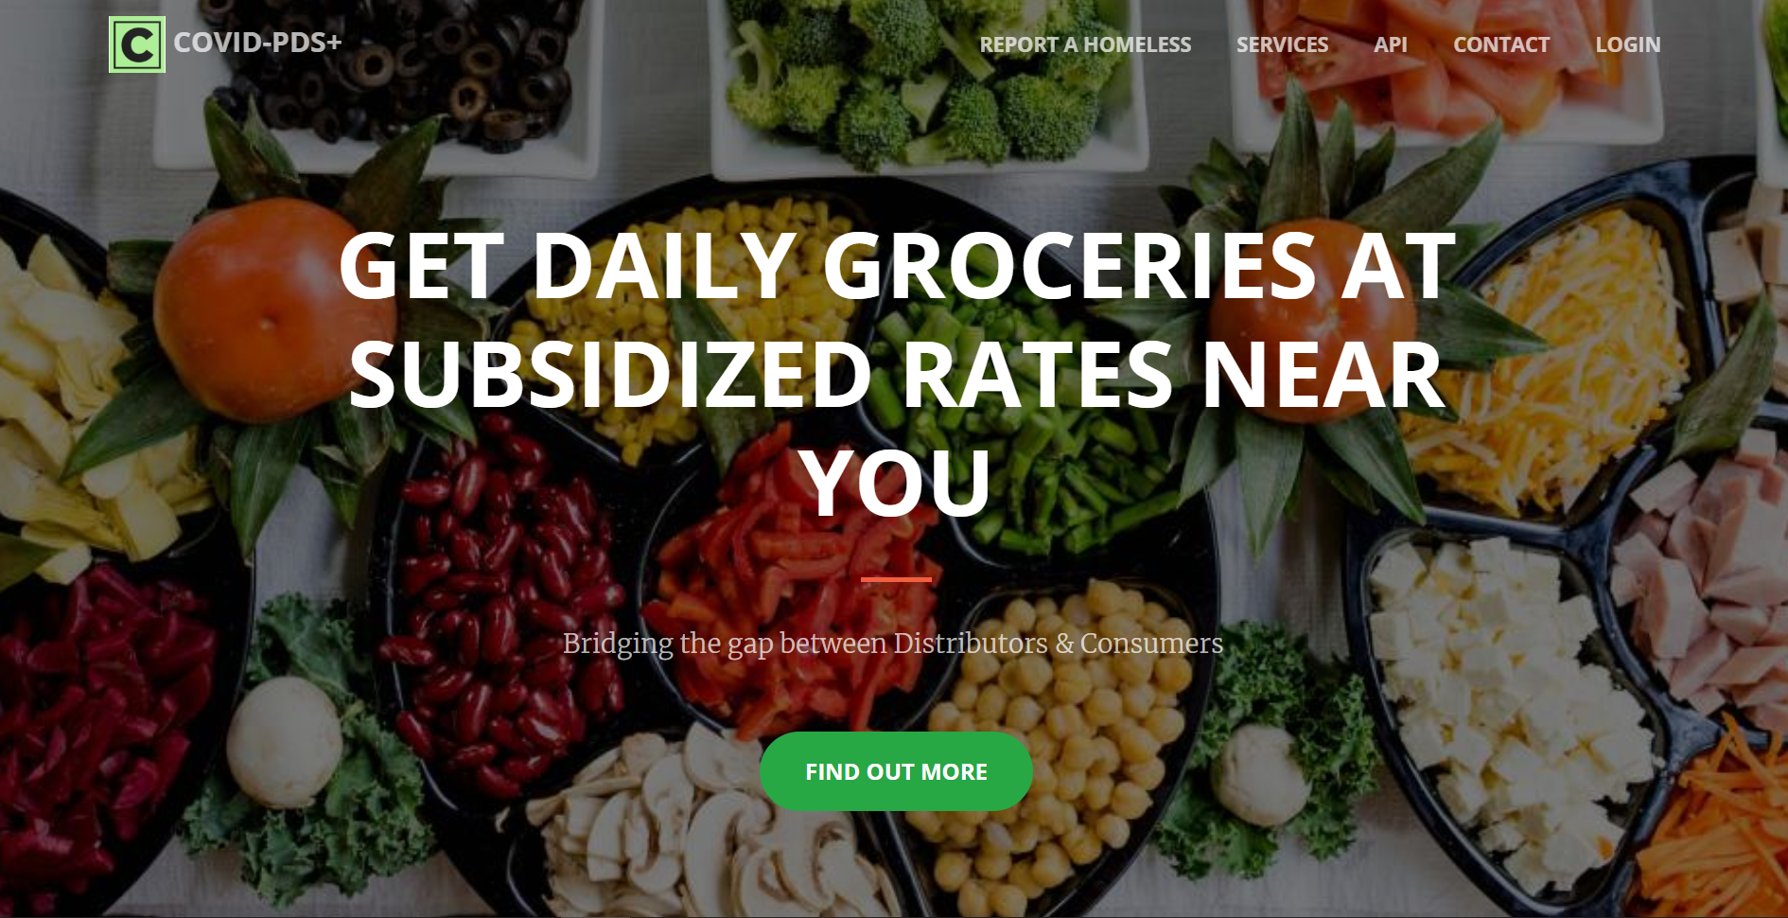




Technology Stacks and Tools Used
A MERN Stack Web Application using NGINX as Reverse Proxy and Load Balancer.
Complete User Interface of the Mobile Application using Adobe XD.
Utilizing the computation power of Spark for Predictive Analytics.
Containerizing the Application using Docker for safe and secure deployment on Cloud Engines.

Slide 7
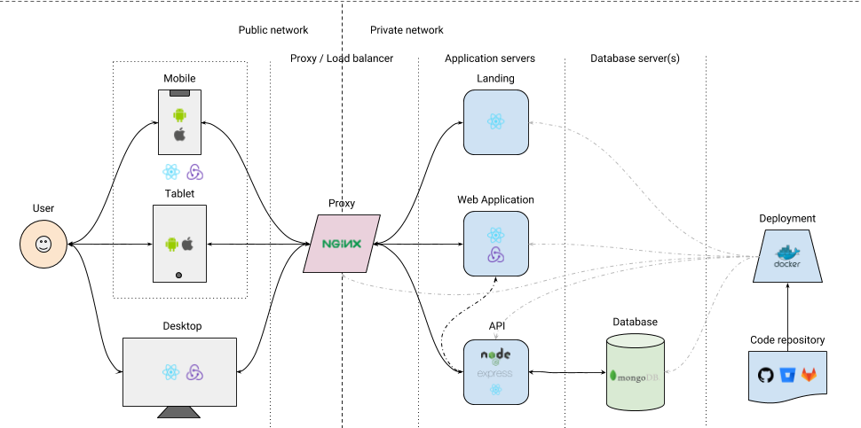


The Web Architecture

Slide 8
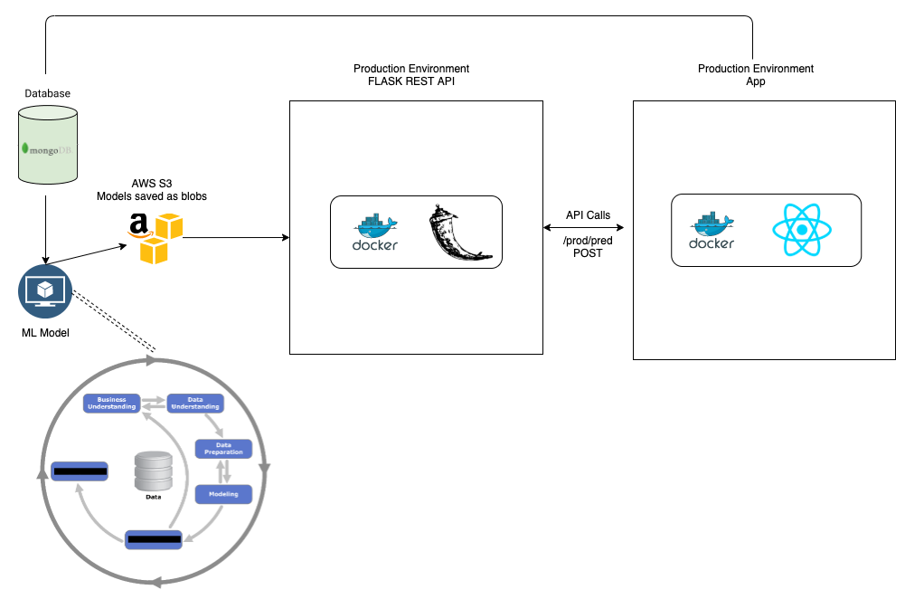

Integrating the ML Model with Web Application

Slide 9

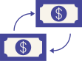
TARGET MARKET
The Poor & Middle Class
The Homeless
The Daily Wage Workers are the most affected due to the lock-down situation.
We are taking the opportunity of providing them food at low cost considering their economic condition.
These people have high chances of getting contaminated due to their surrounding hygiene.
We are encouraging citizens to report such cases in our Application. This information is shared with the Local Authorities/NGOs, to provide them residence.

Slide 10
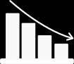

REVENUE MODEL
Interstitial & Admob ads from Google
Daily active users
User Retention
Location of Users
Incentive per head from Distributors
Connecting medium between the Customers & Distributors.
Our app can fasten and channelize the distribution.
APIs for Analytics
Data after proper Masking of sensitive information, can be used by Analytic companies.
A highly profitable model in the time of Data Monetization.

Slide 11
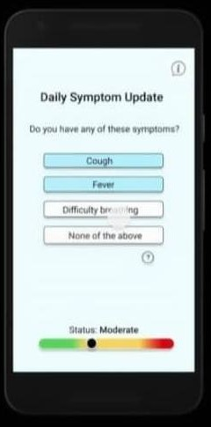

Phase 2: COVID-HEALTHCARE+
(Towards Social Welfare)
The Revenue earned to be used towards social welfare as COVID Healthcare+ in Phase 2 of business model as Social Responsibility.
Here the implementation caters the target market Rural India.
In house treatment to be provided to COVID positive cases where healthcare facilities aren’t available.
ASHA (Accredited Social Health Activist) workers to be trained, to provide AT-Home Patient Triaging, to the COVID Positive cases in Rural India.
COVID-19 spread to be periodically monitored.

Slide 12
Phase 2: The Implementation
STAGE 1:
Building components of the system (apps, bots, educational material)
STAGE 2:
Contact Stakeholders (government,phone service providers)
Linking with Aadhar Database.
STAGE 3:
Dissemination of plan to public (via TV,radio.etc) and training of ASHA Workers.
STAGE 4:
Beta Test on target village.
STAGE 7:
Periodically monitor for community spread of COVID-19 in India.
STAGE 5:
Initiate system in other rural areas.
STAGE 6:
Modify and scale system for urban areas.
COVID-HEALTHCARE+

Slide 13
OUR WEBSITE
https://bit.ly/covid-pds

Slide 14

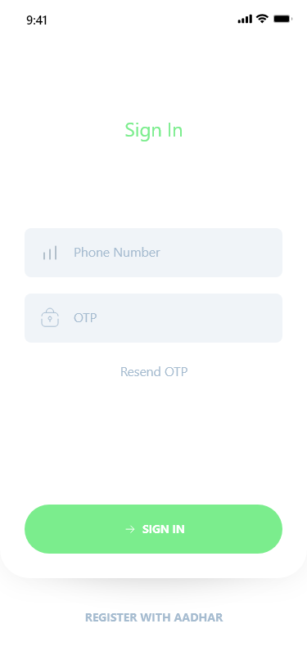
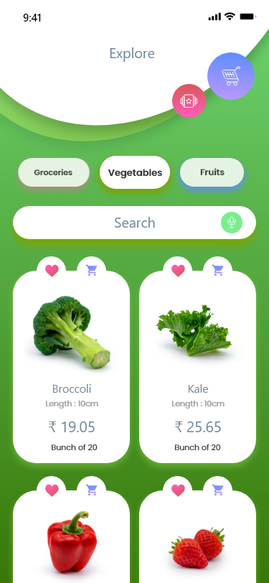
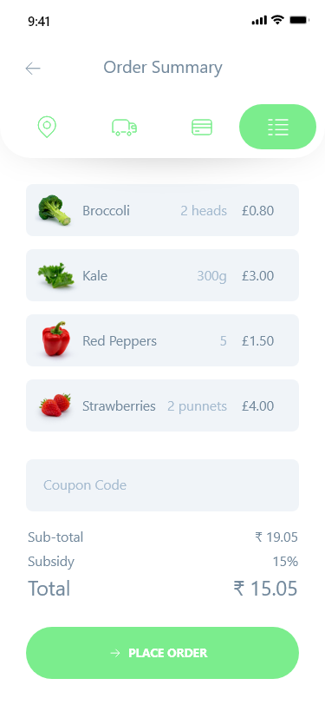
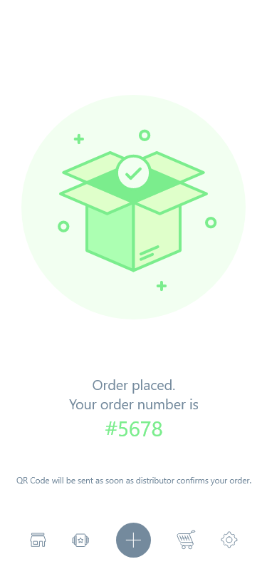

ANDROID APP UI
https://bit.ly/covid-pds-apk

Slide 15
THANK YOU!
NOVATE+
HEALTHCARE
Visit our Site: https://bit.ly/covid-pds
Download App: https://bit.ly/covid-pds-apk

